Slide 1
Classifying Fake News Articles Using Natural Language Processing to Identify In-Article Attribution as a Supervised Learning Estimator
Guided By
Presented By

Slide 2
Synopsis
Objective
Introduction
Existing methods
Proposing model
System Architecture
Algorithm
Sample Input
References

Slide 3
Objective
Fake news has been demonstrated to be problematic in multiple ways. It has been shown to have real influence on public perception and the ability to shape regional and national dialogue . It has harmed businesses and individuals and even resulted in death, when an individual responded to a hoax . It has caused some teenagers to reject the concept of media objectivity and many students can’t reliably tell the difference between real and faked articles . It is even thought to have influenced the 2016 United States elections .

Slide 4
Fake news can be spread deliberately by humans or indiscriminately by bot armies , with the latter giving a nefarious article significant reach. Not just articles are faked, in many cases fake, mislabeled or deceptive images are also used to maximize impact . Some contend that fake news is a “plague” on society’s digital infrastructure . Many are working to combat it. Farajtabar, et al. , for example, has proposed a system based on points, while Haigh, Haigh and Kozak have suggested the use of “peer-to-peer counter propaganda

Slide 5
Introduction
Intentionally deceptive content presented under the guise of legitimate journalism (or ‘fake news,’ as it is commonly known) is a worldwide information accuracy and integrity problem that affects opinion forming, decision making, and voting patterns. Most fake news is initially distributed over social media conduits like Facebook and Twitter and later finds its way onto mainstream media platforms such as traditional television and radio news. The fake news stories that are initially seeded over social media platforms share key linguistic characteristics such as excessive use of unsubstantiated hyperbole and non-attributed quoted content. The results of a fake news identification study that documents the performance of a fake news classifier are presented and discussed in this paper.

Slide 6
Literature Survey
[1] M. Balmas, “When Fake News Becomes Real: Combined Exposure to Multiple News Sources and Political Attitudes of Inefficacy, Alienation, and Cynicism,” Communic. Res., vol. 41, no. 3, pp. 430–454, 2014.
[2] C. Silverman and J. Singer-Vine, “Most Americans Who See Fake News Believe It, New Survey Says,” BuzzFeed News, 06-Dec-2016.
[3] P. R. Brewer, D. G. Young, and M. Morreale, “The Impact of Real News about ‘“Fake News”’: Intertextual Processes and Political Satire,” Int. J. Public Opin. Res., vol. 25, no. 3, 2013.
[4] D. Berkowitz and D. A. Schwartz, “Miley, CNN and The Onion,” Journal. Pract., vol. 10, no. 1, pp. 1–17, Jan. 2016.

Slide 7
[5] C. Kang, “Fake News Onslaught Targets Pizzeria as Nest of Child-Trafficking,” New York Times, 21-Nov-2016.
[6] C. Kang and A. Goldman, “In Washington Pizzeria Attack, Fake News Brought Real Guns,” New York Times, 05-Dec-2016.

Slide 8
Existing System
In this paper, the research process, technical analysis, technical linguistics work, and classifier performance and results are presented. The paper concludes with a discussion of how the current system will evolve into an influence mining system. The fake news stories that are initially seeded over social media platforms share key linguistic characteristics such as excessive use of unsubstantiated hyperbole and non-attributed quoted content. The results of a fake news identification study that documents the performance of a fake news classifier are presented and discussed in this paper.

Slide 9
Proposing model
In this paper author is describing concept to detect fake news from social media or document corpus using Natural Language Processing and attribution supervised learning estimator. News documents or articles will be uploaded to application and then by using Natural Language Processing to extract quotes, verbs and name entity recognition (extracting organizations or person names) from documents to compute score, verbs, quotes and name entity also called as attribution. Using supervised learning estimator we will calculate score between sum of verbs, sum of name entity and sum of quotes divided by total sentence length. If score greater than 0 then news will be consider as REAL and if less than 0 then new will be consider as FAKE.

Slide 10
Modules
Tensorflow
TensorFlow is a free and open-source software library for dataflow and differentiable programming across a range of tasks. It is a symbolic math library, and is also used for machine learning applications such as neural networks. It is used for both research and production at Google.‍
TensorFlow was developed by the Google Brain team for internal Google use. It was released under the Apache 2.0 open-source license on November 9, 2015.
Numpy
Numpy is a general-purpose array-processing package. It provides a high-performance multidimensional array object, and tools for working with these arrays.
It is the fundamental package for scientific computing with Python. It contains various features including these important ones:
A powerful N-dimensional array object
Sophisticated (broadcasting) functions
Tools for integrating C/C++ and Fortran code
Useful linear algebra, Fourier transform, and random number capabilities
Besides its obvious scientific uses, Numpy can also be used as an efficient multi-dimensional container of generic data. Arbitrary data-types can be defined using Numpy which allows Numpy to seamlessly and speedily integrate with a wide variety of databases.

Slide 11
Pandas
Pandas is an open-source Python Library providing high-performance data manipulation and analysis tool using its powerful data structures. Python was majorly used for data munging and preparation. It had very little contribution towards data analysis. Pandas solved this problem. Using Pandas, we can accomplish five typical steps in the processing and analysis of data, regardless of the origin of data load, prepare, manipulate, model, and analyze. Python with Pandas is used in a wide range of fields including
academic and commercial domains including finance, economics, Statistics, analytics, etc.
Matplotlib
Matplotlib is a Python 2D plotting library which produces publication quality figures in a variety of hardcopy formats and interactive environments across platforms. Matplotlib can be used in Python scripts, the Python and IPython shells, the Jupyter Notebook, web application servers, and four graphical user interface toolkits. Matplotlib tries to make easy things easy and hard things possible. You can generate plots, histograms, power spectra, bar charts, error charts, scatter plots, etc., with just a few lines of code. For examples, see the sample plots and thumbnail gallery.
For simple plotting the pyplot module provides a MATLAB-like interface, particularly when combined with IPython. For the power user, you have full control of line styles, font properties, axes properties, etc, via an object oriented interface or via a set of functions familiar to MATLAB users.
Scikit – learn
Scikit-learn provides a range of supervised and unsupervised learning algorithms via a consistent interface in Python. It is licensed under a permissive simplified BSD license and is distributed under many Linux distributions, encouraging academic and commercial use. The library is built upon the SciPy (Scientific Python) that must be installed before you can use scikit-learn. This stack that includes:

Slide 12
NumPy: Base n-dimensional array package
SciPy: Fundamental library for scientific computing
Matplotlib: Comprehensive 2D/3D plotting
IPython: Enhanced interactive console
Sympy: Symbolic mathematics
Pandas: Data structures and analysis
Extensions or modules for SciPy care conventionally named SciKits. As such, the module

Slide 13
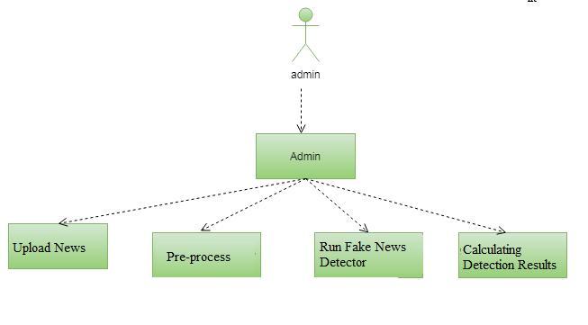
UML

Slide 14
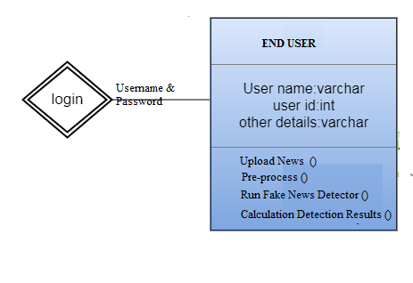

Slide 15
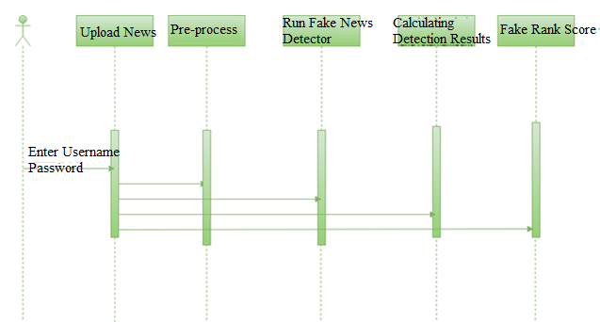

Slide 16
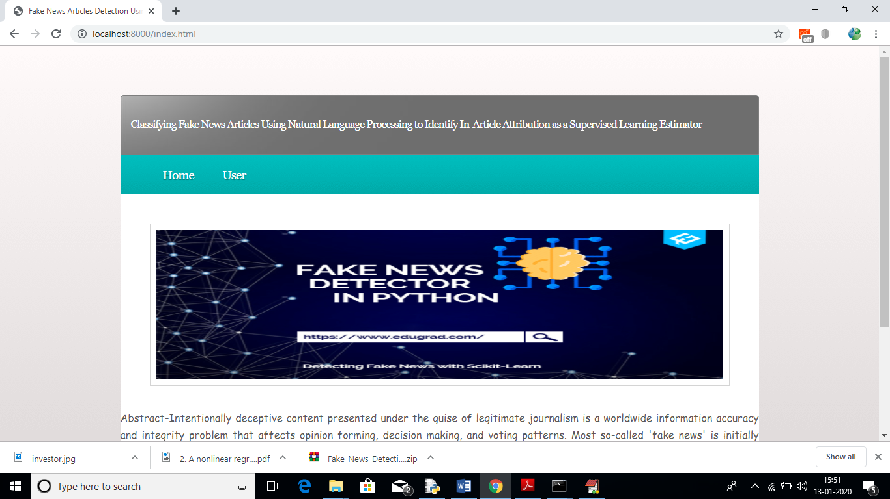
Screen Shots

Slide 17
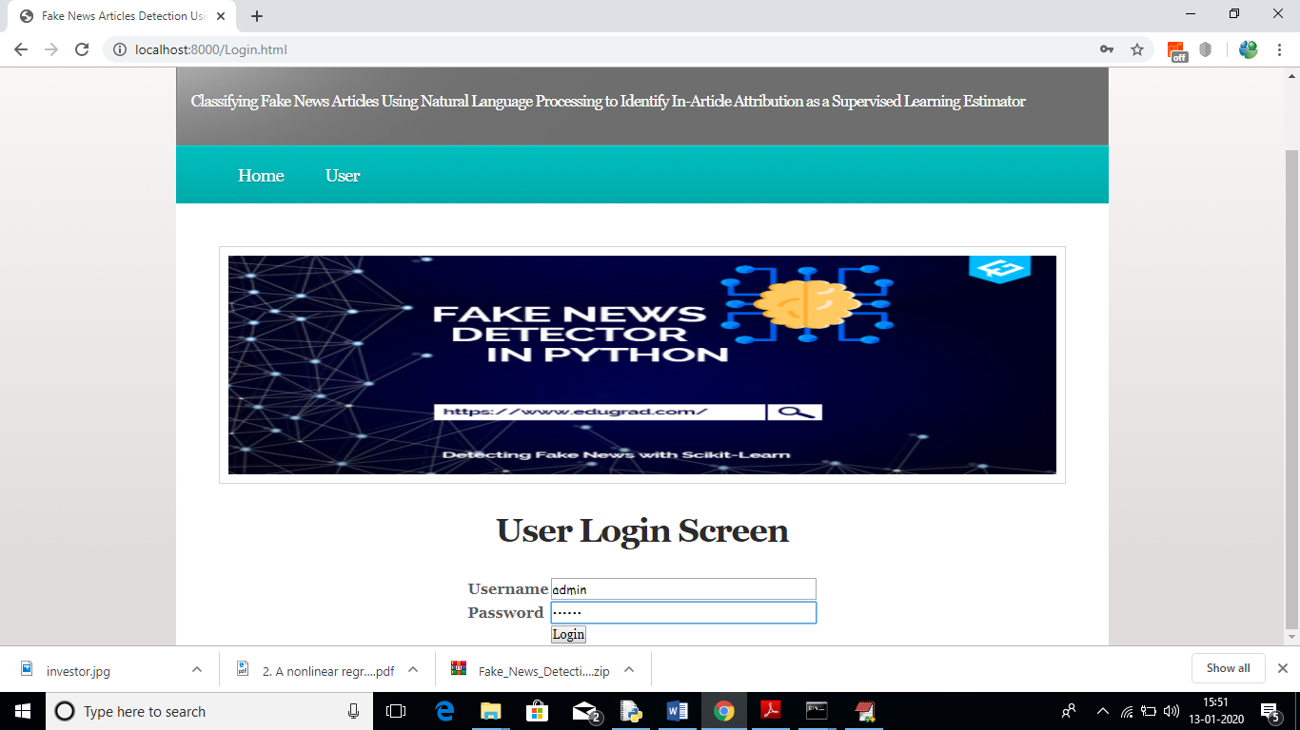

Slide 18
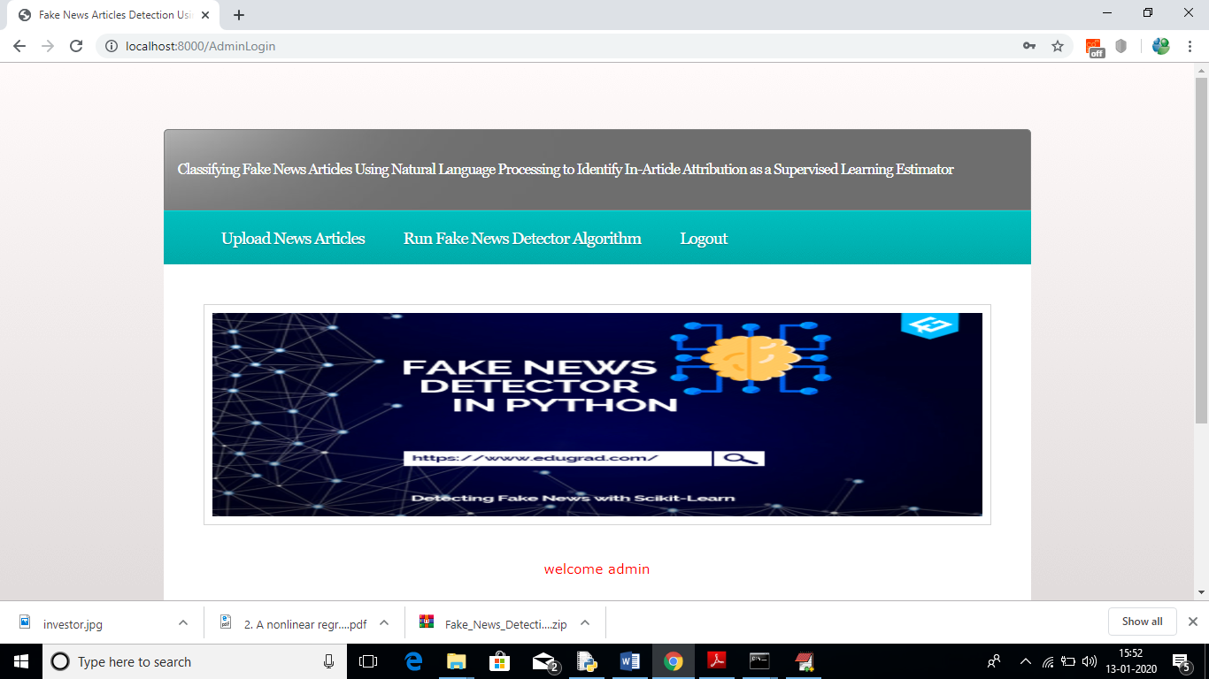

Slide 19
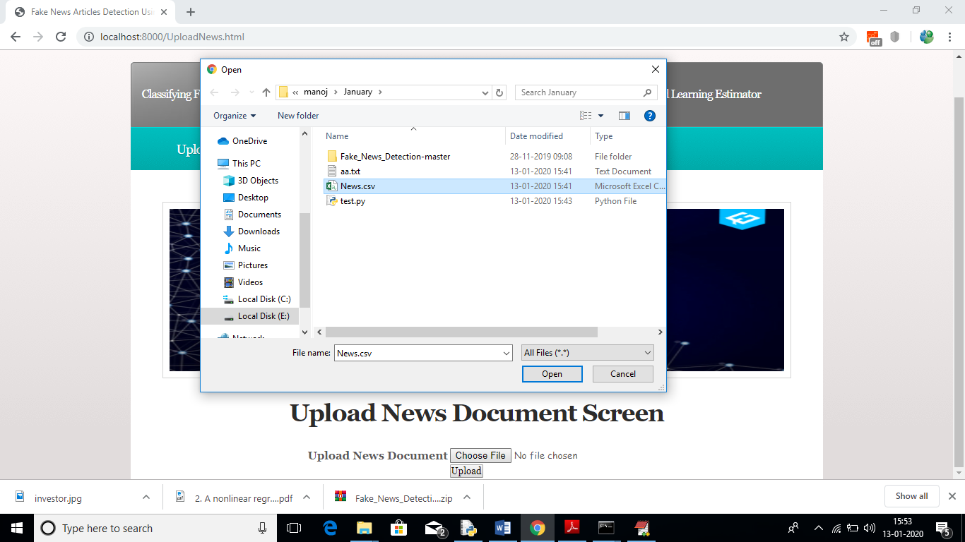

Slide 20
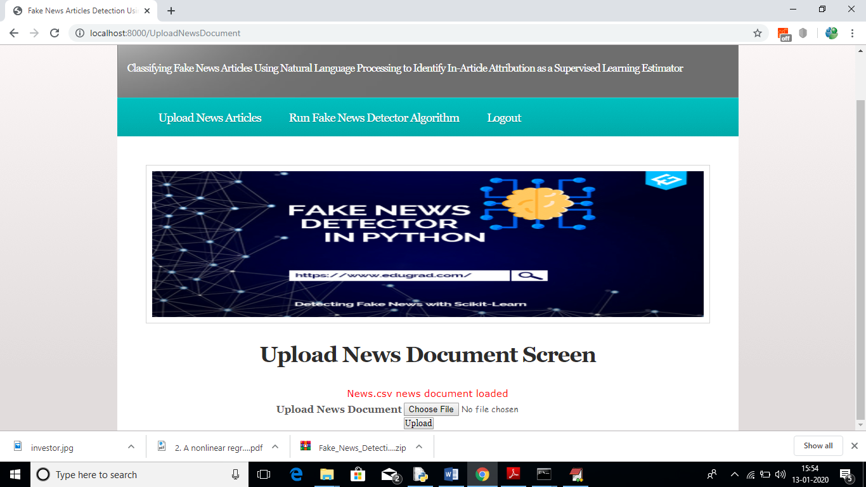

Slide 21
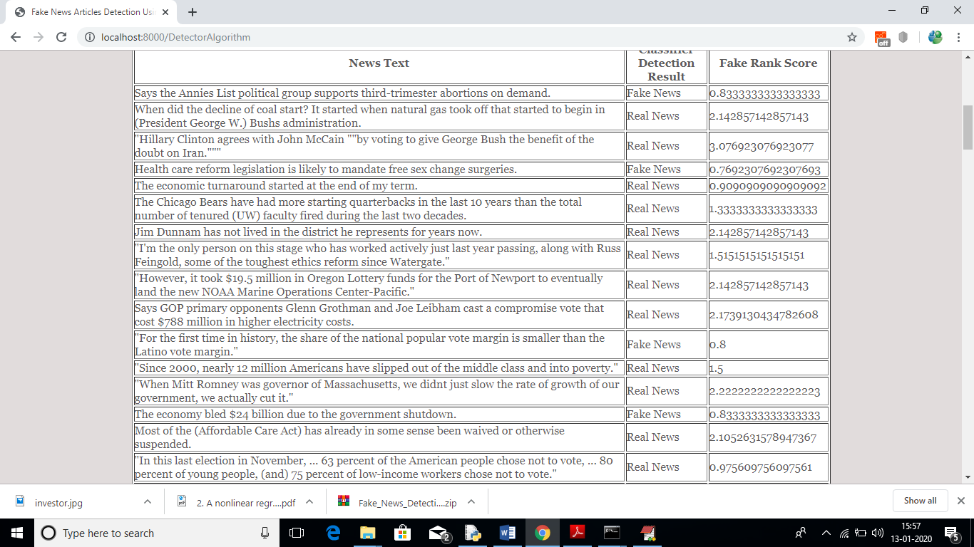

Slide 22
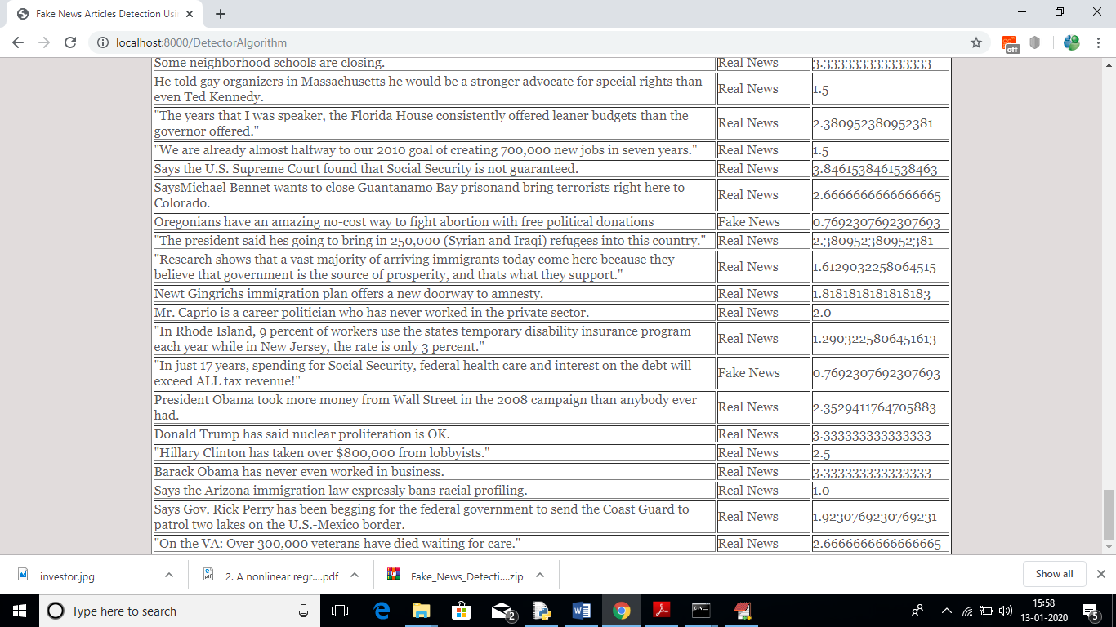

Slide 23
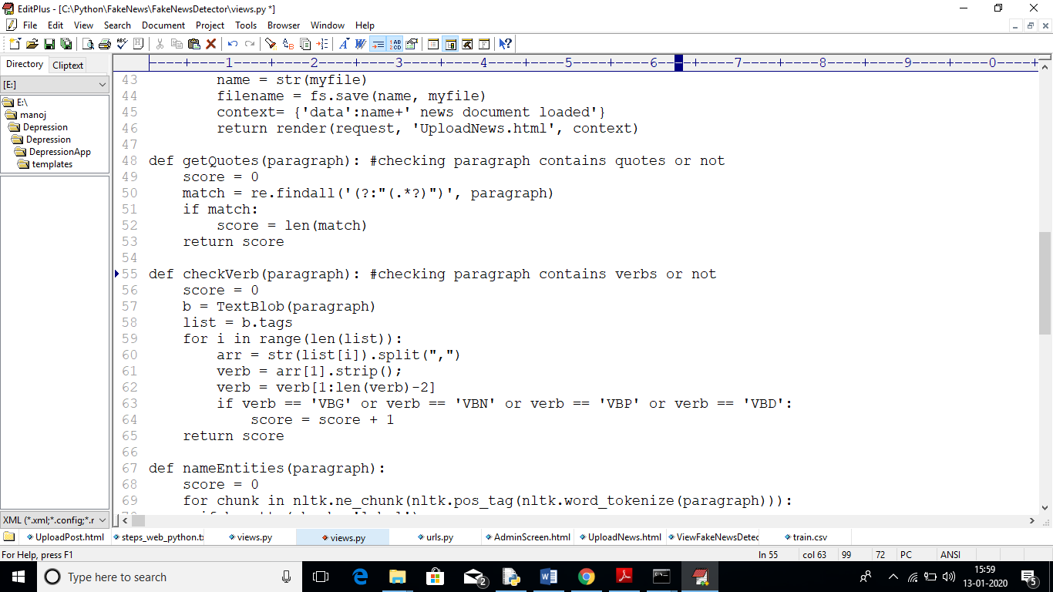

Slide 24
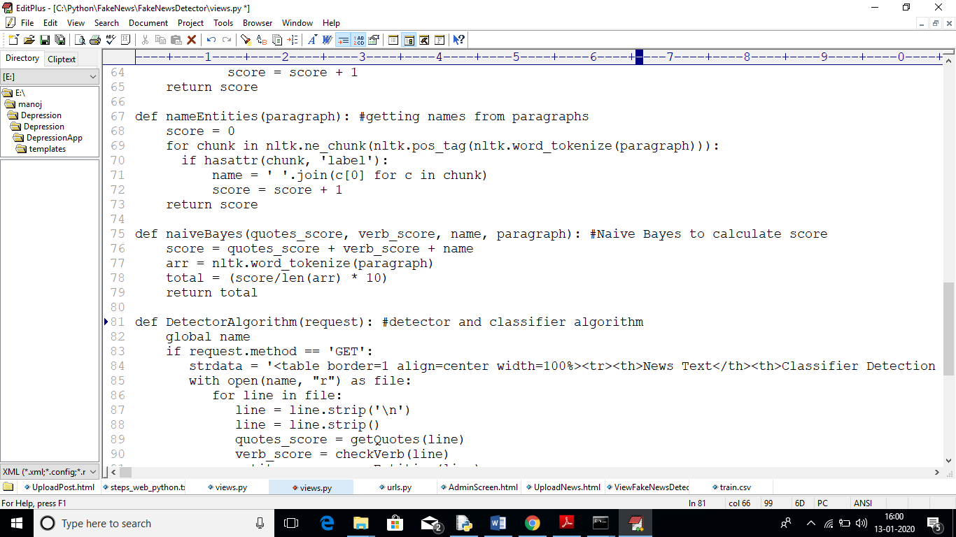

Slide 25
CONCLUSION
This paper presented the results of a study that produced a limited fake news detection system. The work presented herein is novel in this topic domain in that it demonstrates the results of a full-spectrum research project that started with qualitative observations and resulted in a working quantitative model. The work presented in this paper is also promising, because it demonstrates a relatively effective level of machine learning classification for large fake news documents with only one extraction feature. Finally, additional research and work to identify and build additional fake news classification grammars is ongoing and should yield a more refined classification scheme for both fake news and direct quotes.

Slide 26
References
[1] M. Balmas, “When Fake News Becomes Real: Combined Exposure to Multiple News Sources and Political Attitudes of Inefficacy, Alienation, and Cynicism,” Communic. Res., vol. 41, no. 3, pp. 430–454, 2014.
[2] C. Silverman and J. Singer-Vine, “Most Americans Who See Fake News Believe It, New Survey Says,” BuzzFeed News, 06-Dec-2016.
[3] P. R. Brewer, D. G. Young, and M. Morreale, “The Impact of Real News about ‘“Fake News”’: Intertextual Processes and Political Satire,” Int. J. Public Opin. Res., vol. 25, no. 3, 2013.
[4] D. Berkowitz and D. A. Schwartz, “Miley, CNN and The Onion,” Journal. Pract., vol. 10, no. 1, pp. 1–17, Jan. 2016.
[5] C. Kang, “Fake News Onslaught Targets Pizzeria as Nest of Child-Trafficking,” New York Times, 21-Nov-2016.
[6] C. Kang and A. Goldman, “In Washington Pizzeria Attack, Fake News Brought Real Guns,” New York Times, 05-Dec-2016.

Slide 27
Thank you

